Slide 1
Fundamentals of Machine Learning Week 6: Text mining
Jonas Moons
All images are either own work, public domain, CC-licensed or fair use
Credits on last slide

Slide 2
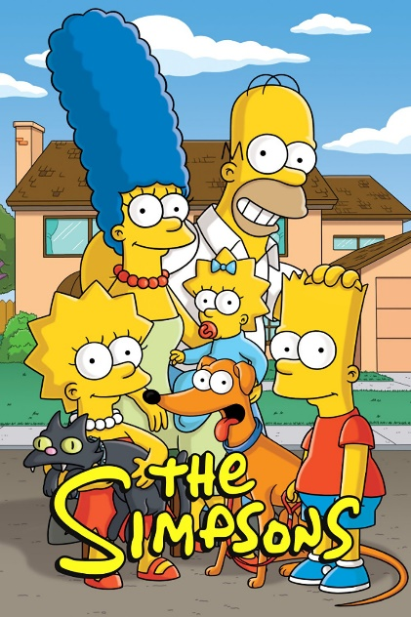
Intro

Slide 3
Topics
Natural Language Processing (NLP)
Modeling text
Classification with Naïve Bayes

Slide 4
Natural language processing
Production
Natural language generation
Text-to-speech
Chatbots
Recognition
Speech recognition
Understanding written text
Translation

Slide 5
Challenges
Requires huge corpora and tagged databases
And specialized algorithms and linguistic expertise
Context is everything
Big differences between languages: relatively well developed for English and some other big and/or (Indo-)European languages, not so much for others

Slide 6
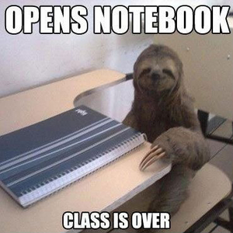
Language is complex…
“What are you doing in this classroom?”
We have:
Semantics (what words mean)
Morphology (how words are formed) → ‘do-ing’, ‘are’, word order
Syntax (sentence construction, word order) → what are you …
Pragmatics (meaning in context) → ‘get out!’

Slide 7
Topics
Natural Language Processing (NLP)
Modeling text
Classification with Naïve Bayes

Slide 8

Bag of words
The ‘bag of words’ model treats a document as a collection of words, and a count for each
It ignores semantics, syntax (word order), morphology and pragmatics (e.g., irony)
Very simple but often effective
Word | Count
You | 8
I | 6
And | 5
Will | 5
Be | 4

Slide 9
Tokenizing
Tokenizing is about breaking text up into units (‘words’)
Relatively easy in English…
(But what about ‘New York’, ‘ice cream’)
A lot harder in ‘agglutinative’ languages like Turkish or Finnish

Slide 10
Document-feature matrix
Features / words / variables
 | flouncy | flow | flower | flowery | flowey | flowier
Doc1 | 0 | 0 | 0 | 1 | 0 | 0
Doc2 | 0 | 0 | 0 | 0 | 0 | 0
Doc3 | 0 | 0 | 2 | 0 | 0 | 0
Doc4 | 0 | 0 | 0 | 0 | 0 | 0
Doc5 | 0 | 1 | 0 | 0 | 0 | 0
High-dimensional & sparse: almost entirely empty

Slide 11
Exercise 1: building a text model
During this week, you are going to work with dialog lines from the Simpsons. Your task during this week is to build a model that distinguishes Bart’s dialogue from Lisa’s dialogue.
Load in the .csv file and have a look at the data set. What will be challenging when building a predictive model?
We will only work with Bart’s and Lisa’s lines. Make the relevant selection in the data set. Tip: this is a selection based on two conditions. Use brackets () around each condition and use | instead of or in Pandas.
Create a document-feature matrix of the text data.
Print a selection of the features/words.
Save your document (this should not freeze your machine, but just in case). Try and make a regular matrix out of the sparse matrix and add it to the data frame. Does it work? How much memory does Python use now?

Slide 12
Lemmatization and stemming
Lemmatization: means reducing a word to its grammatical stem
Removing pre- and suffixes for things like gender, number, tense, aspect, etc.
Going, goes, gone, go → go
Falo, falas, fala, falamos, falam, falava, falavas, falávamos, falavam, falei, falaste, falou, falámos, falaram, falarei, falarás, falará, falaremos, falarão, falaria, falarias falaria, falaríamos, falariam,… → falar
Not included in sklearn

Slide 13
Topics
Natural Language Processing (NLP)
Modeling text
Classification with Naïve Bayes

Slide 14
Bayes’ theorem
P(“offer”|spam) = 50%
P(“offer” & spam) = 15%
In spam, the word occurs in 50% of mail
If we encounter the word “offer”, the e-mail is about twice as likely (15/7) to be spam than not
P(spam) = 30%
P(mail) = 70%
The majority of e-mail is not spam
P(“offer”|mail) = 10%
The word “offer”
occurs in 10% of
regular mail
P(“offer” & mail) = 7%

Slide 15
Bayes’ theorem in text mining
We can use Bayes’ theorem to calculate a probability that a text belongs to a certain category (e.g., spam)
The frequency of each word determines the probability
But how do we combine the probabilities of the different words?

Slide 16
Naïve Bayes
If I flip two coins, the probability of one coin being heads does not influence the other: they are independent. We can multiply the probabilities.
The probabilities of two words being in a text (e.g., ‘police’ and ‘crime’) are definitely not independent
Yet this is exactly what is assumed in Naïve Bayes (hence: ‘naïve’), and it works well in practice

Slide 17
Exercise 2: Naïve Bayes
For this exercise, we will not use example code. Instead, you will write the code yourself based on the kind of code that you before. See the Cookbook for reference.
See the documentation of sklearn.naive_bayes_MultinomialNB for the Naive Bayes model object.
Steps:
Import the relevant libraries and/or objects
Split the data into a training and a test set
Train a NB model on the training set
Predict the class (Lisa or Bart) of the test set.
What is the accuracy of your model?

Slide 18
Prior probability
If the distribution of your classes is uneven, the prior probability will reflect this
Simpsons example: given no other information, the algorithm will classify the utterance as Bart’s
Whether this is a problem, depends on your goal (preference for accuracy/precision/recall)
If you want, you can sample both classes evenly, or explicitly model your prior (for some models)

Slide 19
Classification
The output of the Naive Bayes algorithm is not actually a class
Instead, it gives probabilities for each class C_{i}:
P(Y = C_{i} | X)
Typically, the classification takes the highest probability

Slide 20



Evaluation of classification
 | Predicted: Not spam | Predicted: Spam
Actual: Not spam | 20 | 10
Actual: Spam | 30 | 50
Confusion matrix:
What proportion is correctly
predicted?
$$accuracy= \frac{20+50}{20+30+10+50}=\frac{70}{110}=0.63$$
How much of the predicted ‘spam’ is actually spam?
$$precision= \frac{50}{50+10}=\frac{50}{60}= 0.83$$
How much of the real spam is predicted as spam?
$$recall= \frac{50}{30+50}=\frac{50}{80}=0.63$$

Slide 21
Exercise 3: evaluation
In this exercise we will evaluate the model and delve further into the data. Remember that you can use the Cookbook for examples of code.
Start where you left off. Create a confusion matrix.
Calculate the accuracy and the recall and precision for both Bart and Lisa
Check out the documentation on how to get the probabilities for a certain text belonging to a class (tip: it’s a method), instead of a categorization. Try it on a line of dialogue.
Create a loop that prints out a few lines of dialogue and the associated probabilities for Bart and Lisa. Tip: the array with the probabilities is 2-dimensional.
Check out the output. Do you see patterns (based on the data and your knowledge of the Simpsons)?

Slide 22
Image credit
Simpons by 20th century Fox, fair use claimed
Sloth meme by author unknown, fair use claimed
Bag by wixin_56: public domain

